Slide 1
Miniprojekt 01
Gruppe L, „Name Zensiert“
(Ibrahim EL sayed, tuan-dat tran,
Johannes waltmann)

Slide 2
Data visualization

Slide 3
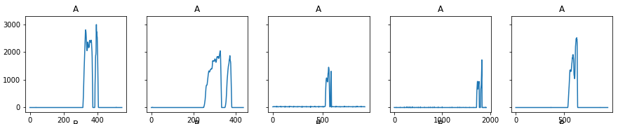
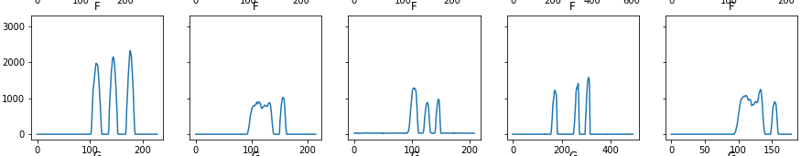
Normale Daten (Force-Spalte)
Korrelation zwischen Force und Strichen erkennbar

Slide 4
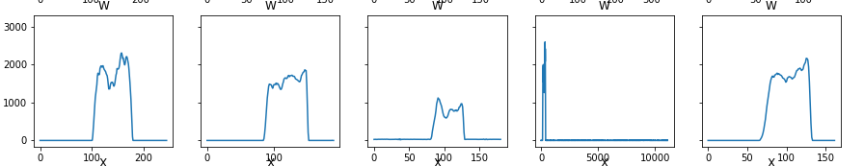
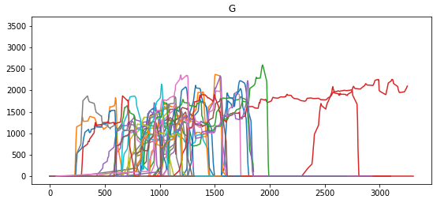
Outlier
????

Slide 5
Data cleanup

Slide 6
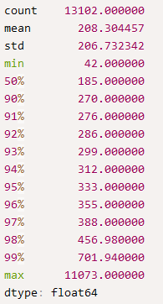
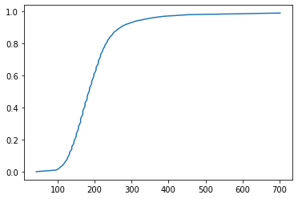
Analyzing length of data entries to determine threshold

Slide 7
Homogenise the data
Ignore data entries above threshold, append data entries to threshold
Sliding window to determine threshold and only use windows (avg), above threshold
Include only data, that is above threshold
Find a ML Model that doesn’t need homogenised data
Remove unnecessary data
Remove ‘Time’-column
Remove ‘Millis’-column
Remove ‘Mag {X,Y,Z}’-column (?)
Create a FNN
Encode Labels (since letters can’t be output)
Flatten data
Dense to some amount of neurons
Dense to the amount of expected different results

Slide 8
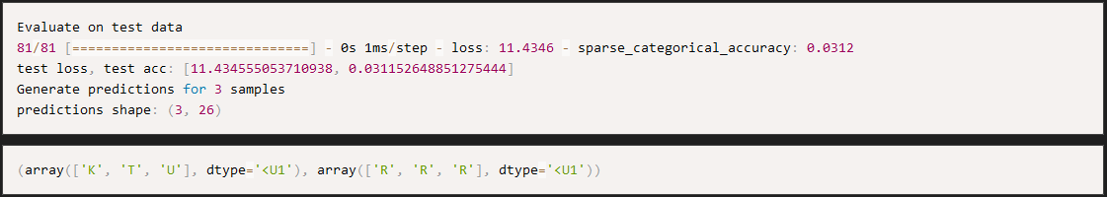
Results
Labels
Predictions
Accuracy with validation data: 3.12%
Accuracy during best epoch with trainings data: 4.32%

