Slide 1
Miniprojekt 01
Meilenstein 04
Gruppe L, „Name Zensiert“
(Ibrahim EL sayed, tuan-dat tran,
Johannes waltmann)

Slide 2
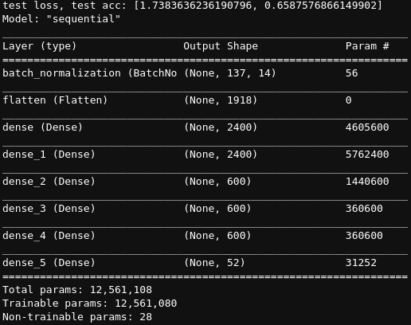
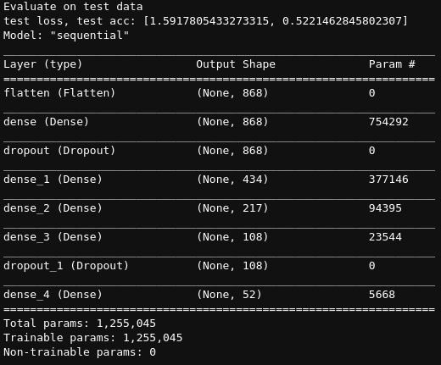
Two Approaches

Slide 3
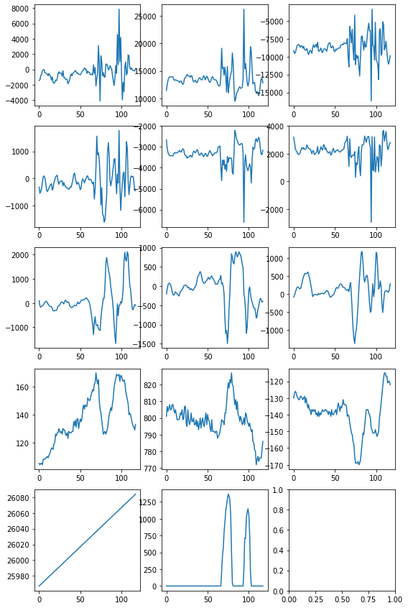
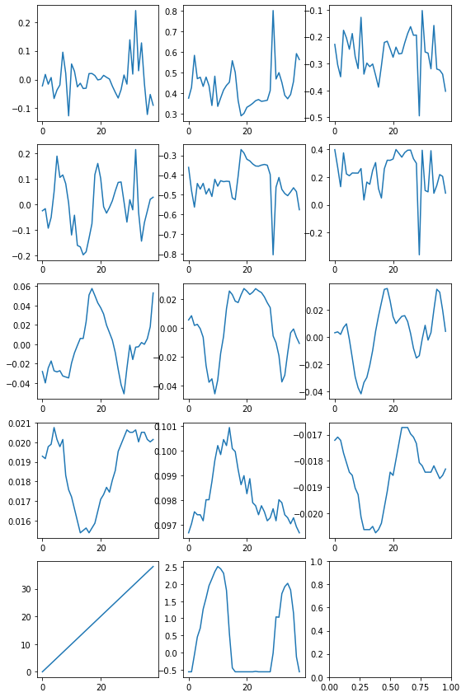
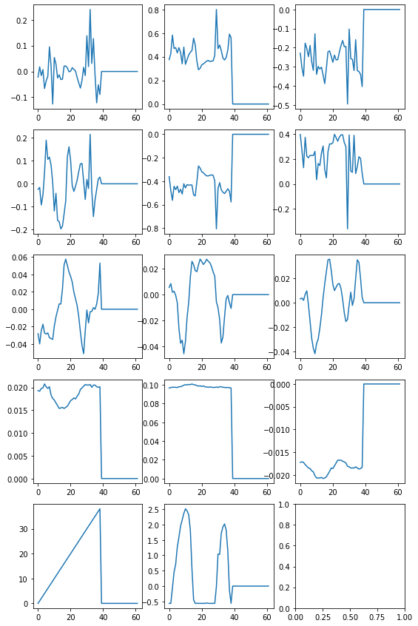
Preprocessing
Truncating
Padding
Normalizing
Truncating
Padding
Normalizing
Padding/Truncating

Slide 4
Neural Network
20 Epochs
High Neuron Count
No Dropout Layers
Batch Normalization
High Accuracy
Overfitting
100 Epochs
Low Neuron Count
Dropout Layers
No Batch Normalization
Low Accuracy
No overfitting
Epoch 20/20
81/81 [==============================] - 0s 5ms/step - loss: 0.1535 - acc: 0.9475 - val_loss: 1.7384 - val_acc: 0.6586
Epoch 100/100
62/62 [==============================] - 0s 4ms/step - loss: 0.8595 - acc: 0.7020 - val_loss: 1.6293 - val_acc: 0.5389

