Slide 1
Miniprojekt 02
Meilenstein 01
Gruppe L, „Name Zensiert“
(Ibrahim EL sayed, tuan-dat tran,
Johannes waltmann)

Slide 2
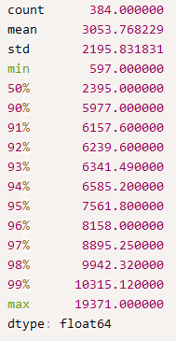
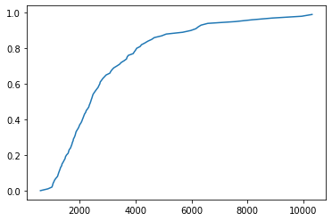
Looking at the data
Sorting: 337 Columns with floats
Jenga: 408 Columns with floats
Float values from 0-1 to 200-300 -> normalization necessary
Looking at lengths of recordings

Slide 3
Next steps
Normalizing data
Implement window slicing
Possibly play around with LSTM Layer

