Slide 1
Miniprojekt 01
Meilenstein 03
Gruppe L, „Name Zensiert“
(Ibrahim EL sayed, tuan-dat tran,
Johannes waltmann)

Slide 2
Data cleanup

Slide 3
Add small lowercase letter data
Created new pickle with lowercase/uppercase letter dataset
Normalize Data
Tried various Scalers from sklearn
Feed data into Neural Network
Play around with parameters

Slide 4
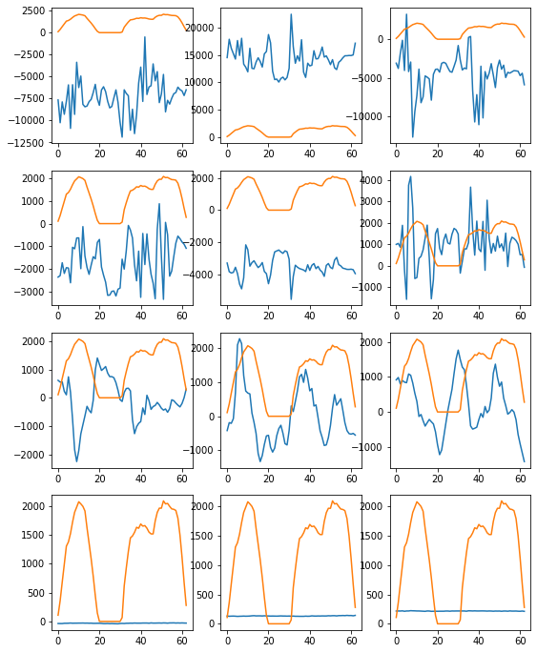
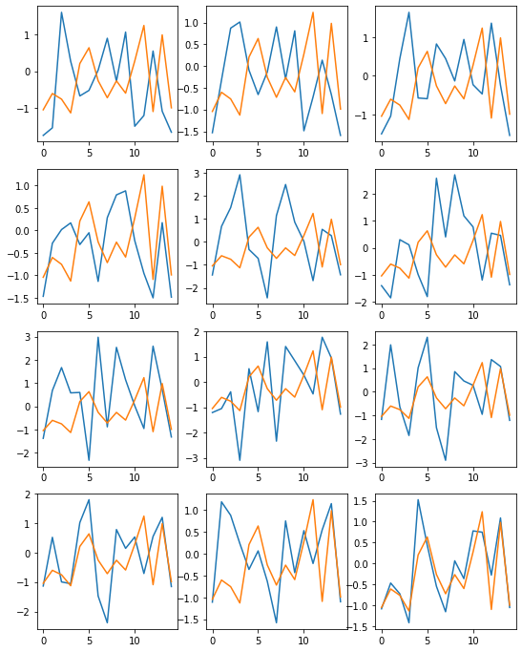
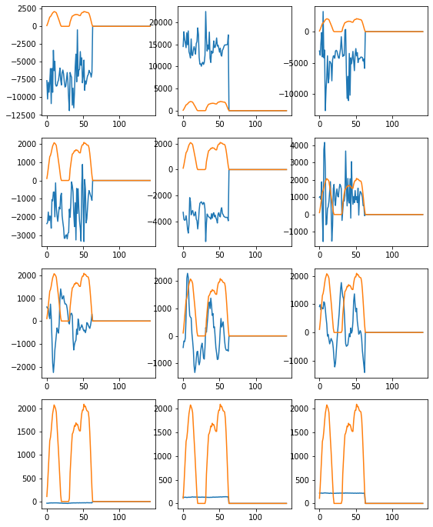
Normalize Data
Standard
Scaler
Padding

Slide 5
Building
Neural Network

Slide 6
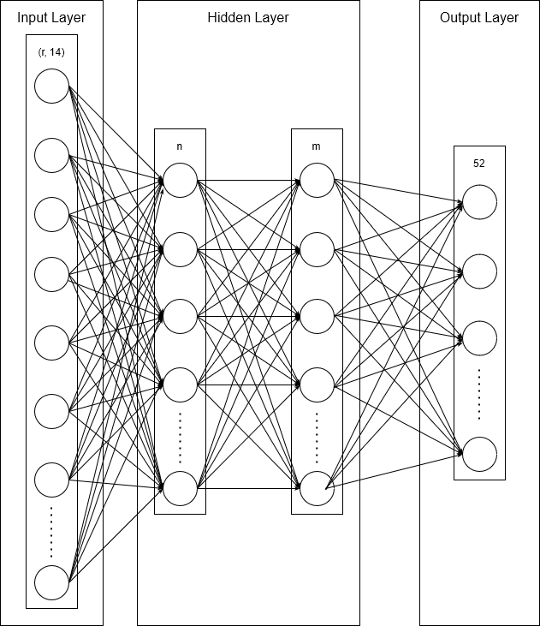
Feed data into neural network
R = Gewähltes Padding
N = Anz. Neuronen im ersten hidden Layer
M = Anz. Neuronen im zweiten hidden Layer
52 ➞ Anz. Der Klassen
Result
Dynamic threshold
Manual Scaling/Normalizing
test loss, test acc: [3.528785228729248, 0.06693673133850098]
Static force threshold
Batch Normalization
test loss, test acc: [1.6860905885696411, 0.6643518805503845]

Slide 7
Future plans

Slide 8
Preprocessing
Compare performance between our 2 truncation methods
Optimize data padding
Optimize data normalization
Get a high accuracy

