Slide 1
Miniprojekt 01
Meilenstein 02
Gruppe L, „Name Zensiert“
(Ibrahim EL sayed, tuan-dat tran,
Johannes waltmann)

Slide 2
Data cleanup

Slide 3
Truncate Data
Only include data below specific length
Cut front and back
Sliding window
Pad data to uniform length
Feed data into Neural Network
Play around with parameters

Slide 4
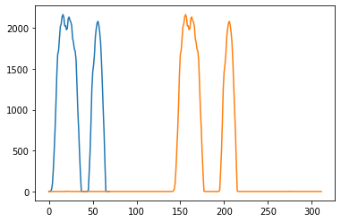
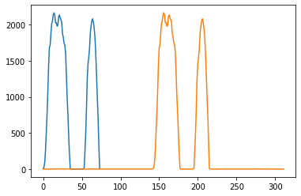
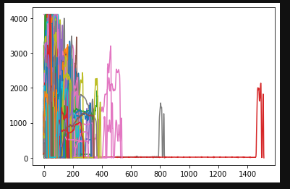
Truncate Data
Sliding Windows
Cut front and back
Overview of all Force values after cutting

Slide 5
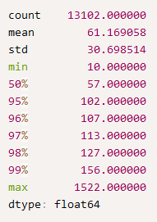
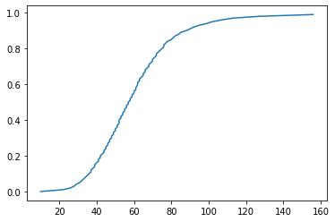
Pad data to uniform length
Coverage
Time

Slide 6
Building
Neural Network

Slide 7
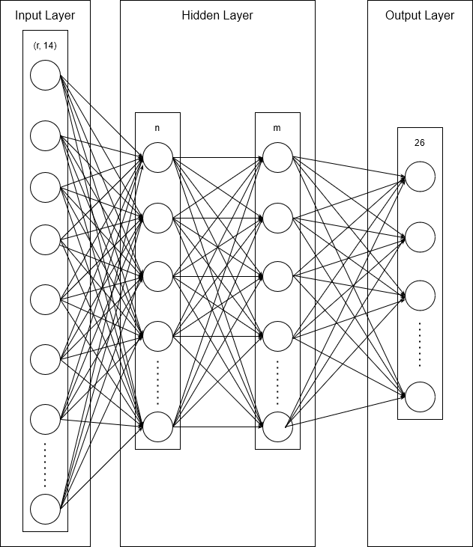
Feed data into neural network
R = Gewähltes Padding
N = Anz. Neuronen im ersten hidden Layer
M = Anz. Neuronen im zweiten hidden Layer
26 ➞ Anz. Der Klassen
Result
Split into Test/Train Datasets
Calculate Average accuracy across 20-30 runs
Evaluate on test data 82/82 [==============================] - 0s 2ms/step
acc: 0.7881

Slide 8
Future plans

Slide 9
Preprocessing
Compare performance between our 2 truncation methods
Find alternative way to normalize data
Tweak parameters of neural network
Tweak pre-processing parameters

