Slide 1
Miniprojekt 02
Meilenstein 02
Gruppe L, „Name Zensiert“
(Ibrahim EL sayed, tuan-dat tran,
Johannes waltmann)

Slide 2
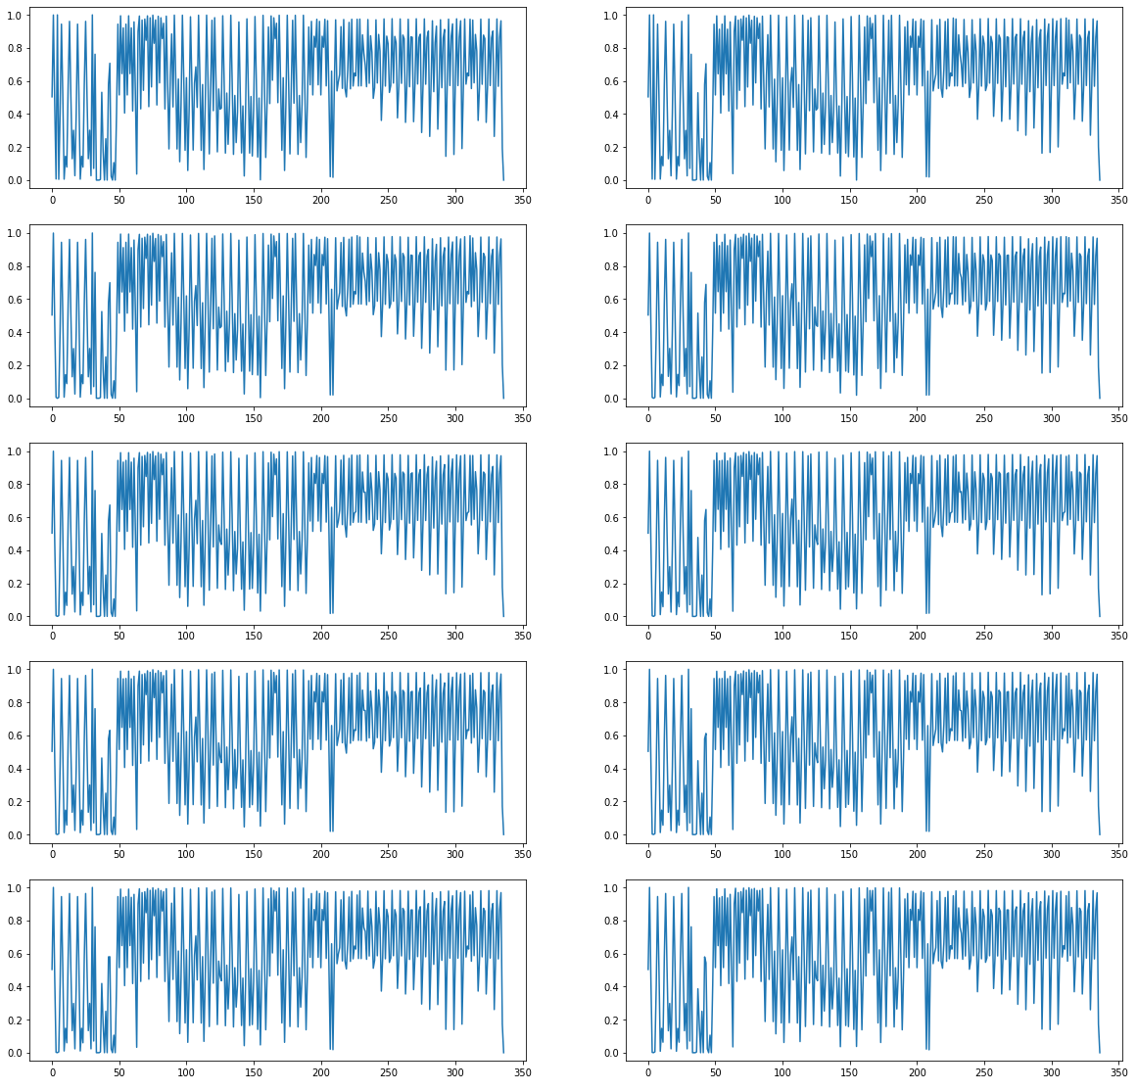
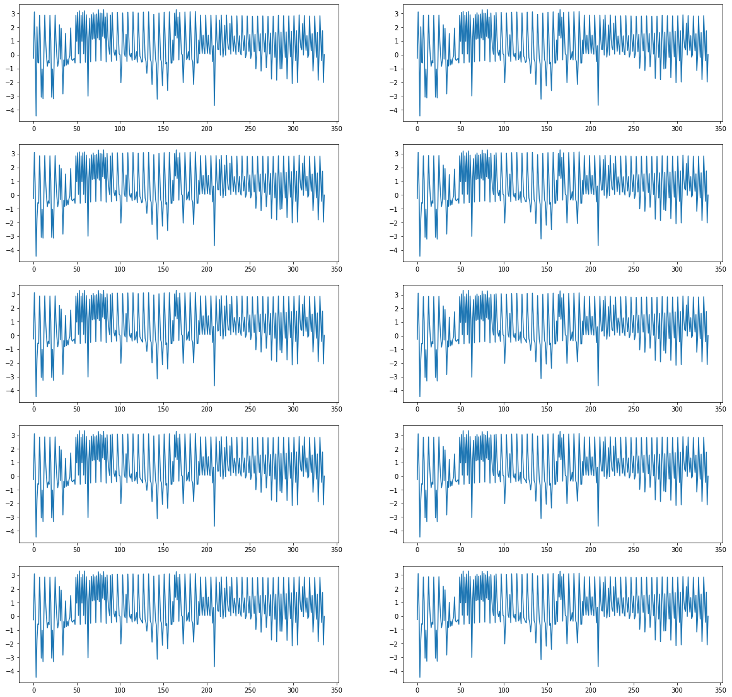
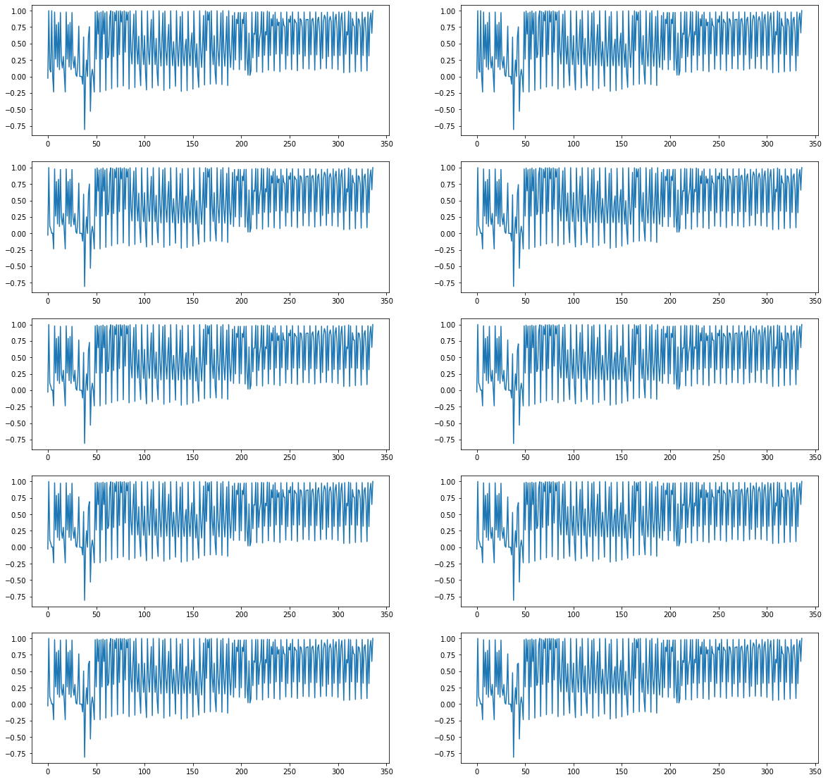
Normalizing
MinMax
Standard
MaxAbs

Slide 3
Pipeline (in construction)
Preprocessing⚠️
Normalize ✔️
Padding ✔️
Window Slicing ⚠️
Train ⚠️

Slide 4
Next steps
Finalize window slicing
Understand how to use LSTM properly
Get %%% for each class of problems

Slide 5
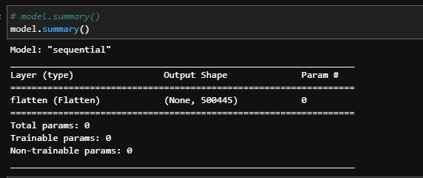
Questions
OOM Error vermeiden
OOM when allocating tensor with shape[500445,100000] and
type float on /job:localhost/replica:0/task:0/device:GPU:0 by
allocator GPU_0_bfc [Op:RandomUniform]
Shape von Daten: Rows x Colums so belassen oder transformieren?
Body/Arm Normalisierung nur untereinander trainieren, also wenn BodyNorm==ArmNorm?
Sliding Window + LSTM?

