Slide 1
Miniprojekt 02
Meilenstein 03
Gruppe L, „Name Zensiert“
(Ibrahim EL sayed, tuan-dat tran,
Johannes waltmann)

Slide 2
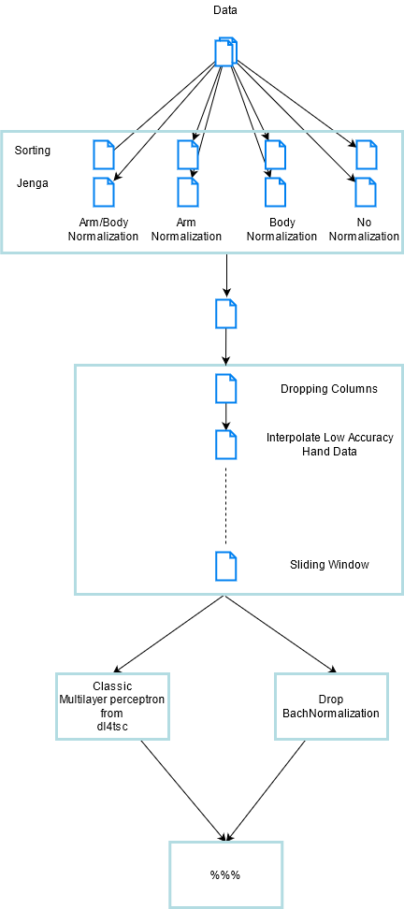
Splitting Scenarios
Choose Scenario
Pre-processing
Train
Evaluate

Slide 3
Split Scenarios
Scenario: Jenga/Sorting
ArmNormalization: True/False
HeightNormalization: True/False
→ 8 Scenarios

Slide 4
Pre-Processing
Drop unnecessary columns (metainformation already saved in dict)
Remove sensor data with low presumed accuracy (where Right-/LeftHandTracking was low)
Pad to multiple of window size (preparation for sliding window)
Interpolate removed data/padding
Sliding window

Slide 5
Train
MLP
Our approach
Flatten
3x Drop/Dense
Output
Adapting LR based on loss
Goodness based on loss
High Epoch
Fixed Neuroncount
(No prior normalization)
Did not reach >6% in any scenario
Flatten
BatchNormalization
5x Drop/Dense
Output
Goodness based on val_acc
Dynamic Neuroncount based on shape/decreasing in regular interval
Inserting LSTM did not yield better results

Slide 6
Results (1/2)
Scenario | ArmNormalization | HeightNormalization | Accuracy
Sorting | ✅ | ✅ | Ca. 38%
Sorting | ✅ | ❌ | Ca. 46%
Sorting | ❌ | ✅ | Ca. 42%
Sorting | ❌ | ❌ | Ca. 42%
Jenga | ✅ | ✅ | Ca. 27%
Jenga | ✅ | ❌ | Ca. 23%
Jenga | ❌ | ✅ | Ca. 25%
Jenga | ❌ | ❌ | Ca. 17%

Slide 7
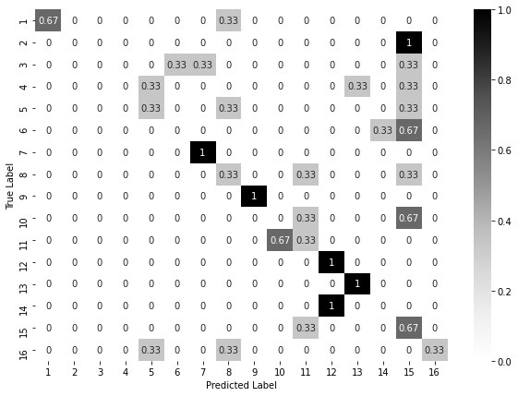
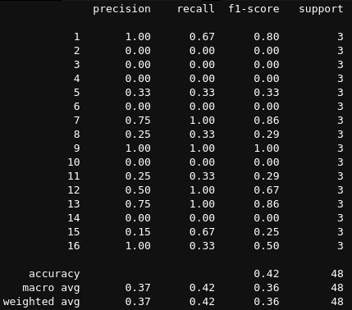
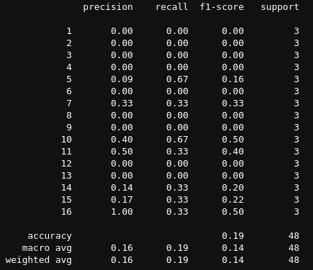
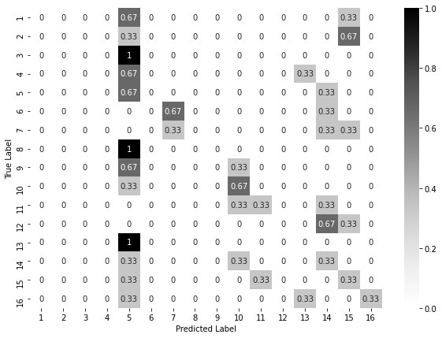
Results (2/2)
Scenario: Sorting
HeightNormalization: True
ArmNormalization: True
Example Accuracy: 42%
Scenario: Jenga
HeightNormalization: False
ArmNormalization: False
Example Accuracy: 19%

Slide 8
Future plans
Tweak model to make it work with LSTM
Include regular normalization (MinMax/Standard)
Context aware normalization (relative movement of hands/head and angular movement)
Modularize code (like models tested in dl-4-tsc)
Make use of callbacks (ReduceLROnPlateau, ModelCheckpoint etc.)

