Slide 1
Abschluss- präsentation
Intelligent User Interfaces
Gruppe L, „Name Zensiert“
(Ibrahim EL sayed, tuan-dat tran,
Johannes waltmann)

Slide 2
Inhaltsverzeichnis
Miniprojekt 1
Preprocessing
Machine Learning
Result
Problems
Miniprojekt 2
Preprocessing
Machine Learning
Result
Problems

Slide 3
Miniprojekt 1 Preprocessing (1/2)
Static ‘Force’ threshold
Dynamic ‘Force’ threshold
Filtering by ‘Force’
Remove unreliable data
Dropping unnecessary columns
Normalize
Padding

Slide 4
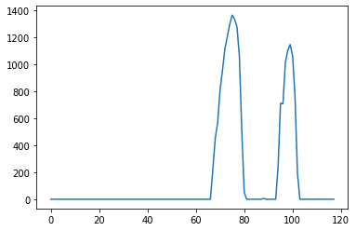
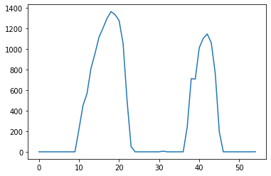
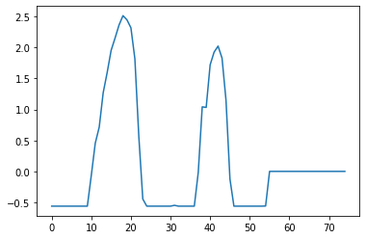
Miniprojekt 1 Preprocessing (2/2)
Raw Force Data
Cut Force Data
Padded Froce Data

Slide 5
Miniprojekt 1 Machine Learning (1/2)
Multiple multilayer perceptron models
Callbacks:
ModelCheckpoint
ReduceLROnPlateau

Slide 6
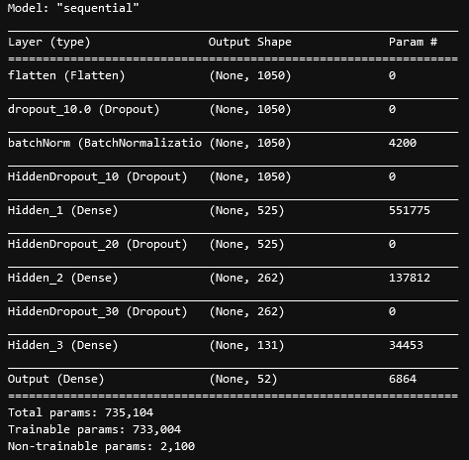
Miniprojekt 1 Machine Learning (2/2)

Slide 7
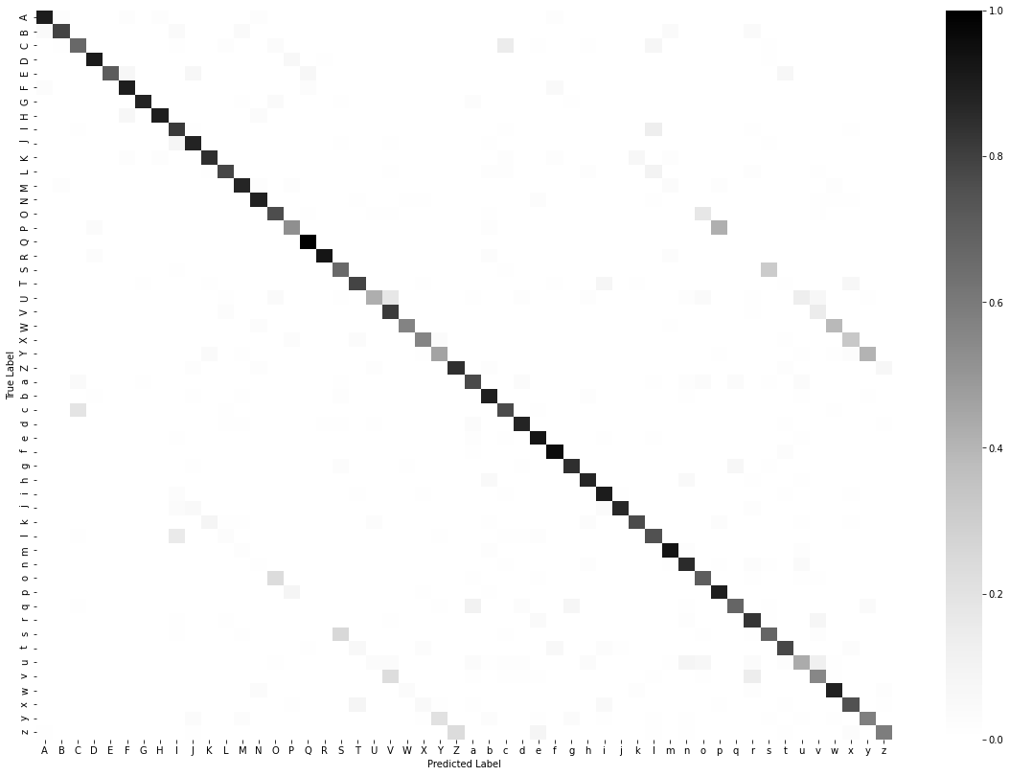

Miniprojekt 1 Result (1/3)

Slide 8
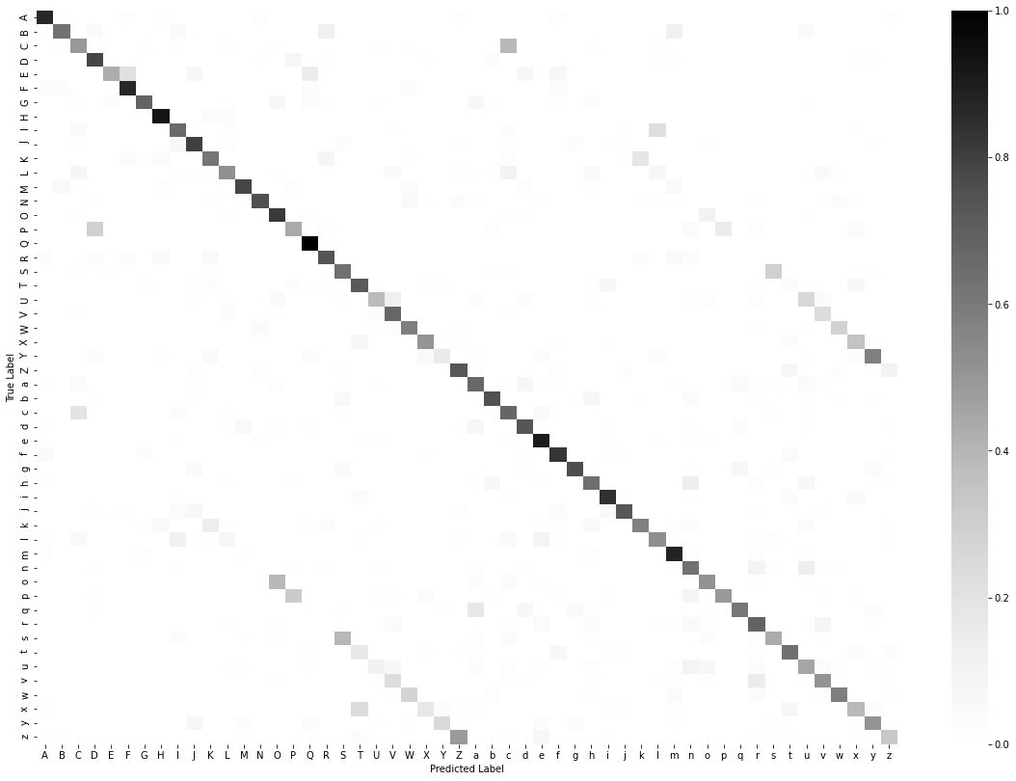

Miniprojekt 1 Result (2/3)

Slide 9
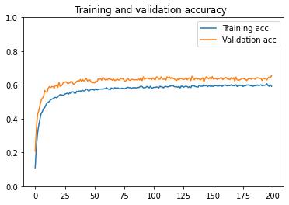
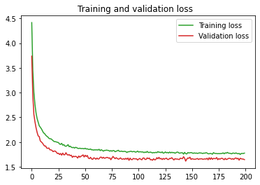
Miniprojekt 1 Result (3/3)

Slide 10
Miniprojekt 1 Problems (1/1)
Mostly implementation problems
Working correctly with shapes
Prediction based on letters
CNN

Slide 11
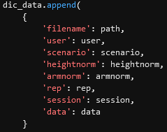
Miniprojekt 2 Preprocessing (1/3)
Dropping unnecessary columns
Remove Data with unreliable data
Normalization over all data
Normalization over single entries
Padding
Interpolation
Sliding Window

Slide 12
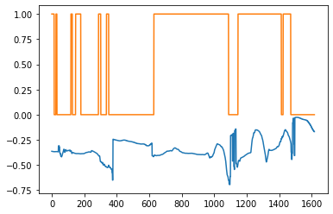
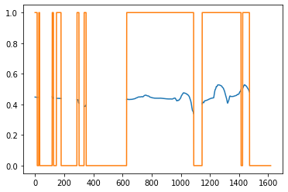
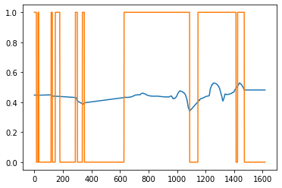
Miniprojekt 2 Preprocessing (2/3)
Base
Dropped Inacc.+Norm.
Interpolation

Slide 13
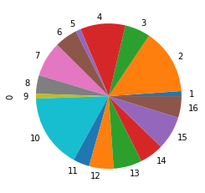
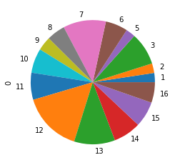
Miniprojekt 2 Preprocessing (3/3)
Training
Test
Key: 1: 754
Key: 2: 9765
Key: 3: 3794
Key: 4: 6707
Key: 5: 786
Key: 6: 3388
Key: 7: 5251
Key: 8: 2761
Key: 9: 724
Key: 10: 11062
Key: 11: 2435
Key: 12: 3651
Key: 13: 4263
Key: 14: 3554
Key: 15: 5031
Key: 16: 3203
Key: 1: 760
Key: 2: 792
Key: 3: 2690
Key: 4: 0
Key: 5: 780
Key: 6: 1836
Key: 7: 3535
Key: 8: 1522
Key: 9: 1152
Key: 10: 2023
Key: 11: 2234
Key: 12: 4942
Key: 13: 3380
Key: 14: 2280
Key: 15: 2122
Key: 16: 1693

Slide 14
Miniprojekt 2 Machine Learning (1/3)
Multiple multilayer perceptron models
Callbacks:
ModelCheckpoint
ReduceLROnPlateau

Slide 15
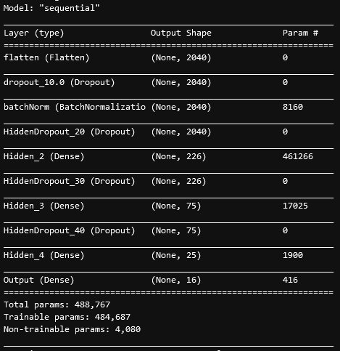
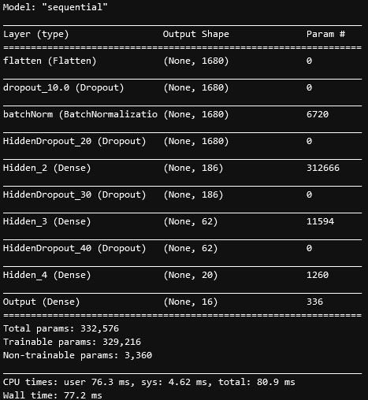
Miniprojekt 2 Machine Learning (2/3)
JNN
SYY

Slide 16
Miniprojekt 2 Machine Learning (3/3)
Testing Window Sizes
SYN
Same amount of Hidden Layers
Neuroncount of hidden Layers proportional to input layer
5 Testruns per WindowSize
Measured Accuracy
Windowsize = Stridesize
Tested Windowsize: 5,10,20,40,80,160
Runs | 5 | 10 | 20 | 40 | 80 | 160
1 | 47% | 44% | 42% | 33% | 30% | 37%
2 | 51% | 46% | 41% | 42% | 37% | 37%
3 | 53% | 44% | 44% | 45% | 37% | 34%
4 | 44% | 44% | 41% | 40% | 40% | 34%
5 | 44% | 41% | 44% | 38% | 29% | 31%
Avg. | 48% | 44% | 42% | 40% | 35% | 35%

Slide 17
Miniprojekt 2 Result (1/3)
Scenario | ArmNormalization | HeightNormalization | Accuracy
Sorting | ✅ | ✅ | Ca. 48%
Sorting | ✅ | ❌ | Ca. 47%
Sorting | ❌ | ✅ | Ca. 57%
Sorting | ❌ | ❌ | Ca. 54%
Jenga | ✅ | ✅ | Ca. 39%
Jenga | ✅ | ❌ | Ca. 27%
Jenga | ❌ | ✅ | Ca. 33%
Jenga | ❌ | ❌ | Ca. 28%

Slide 18
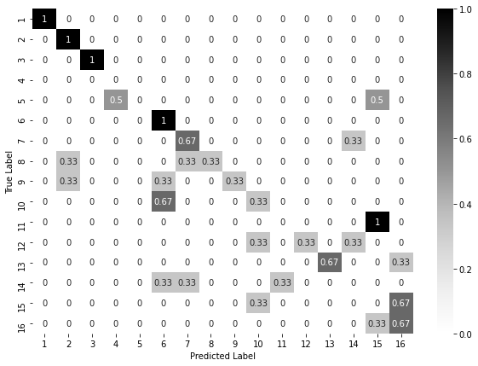
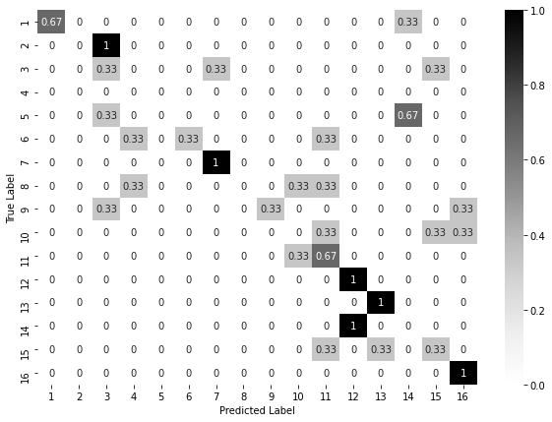


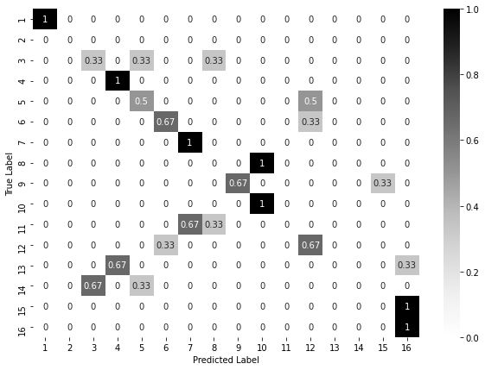
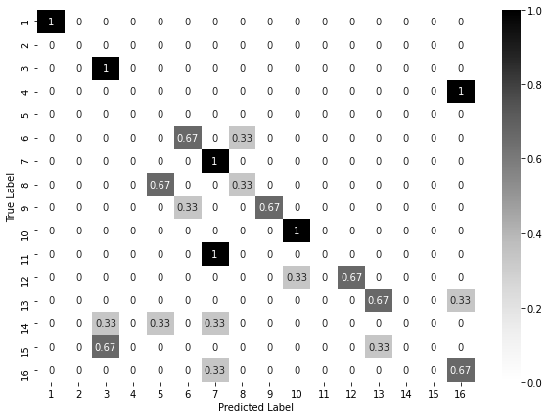


Miniprojekt 2 Result (2/3)
SYY
SYN
SNN
SNY

Slide 19
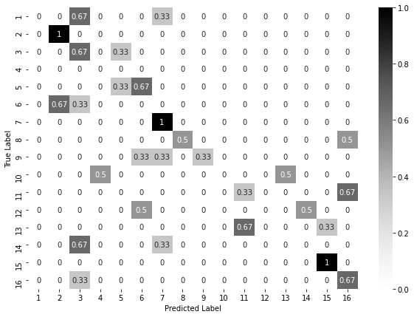
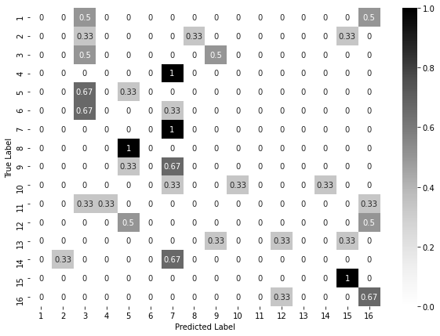


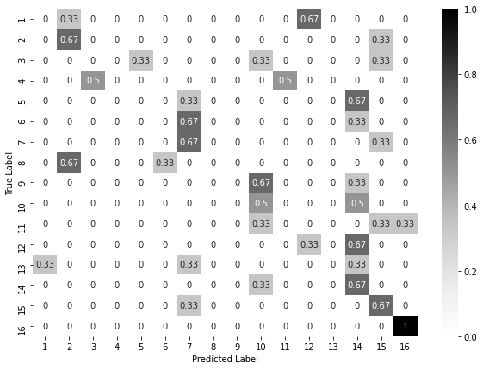
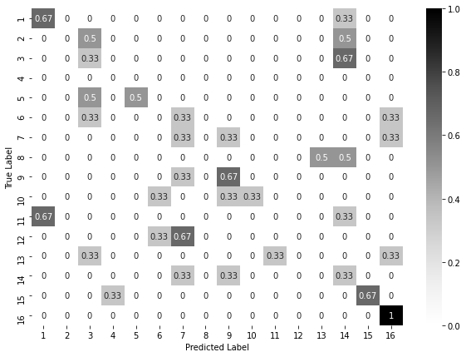


Miniprojekt 2 Result (3/3)
JYY
JYN
JNN
JNY

Slide 20
Miniprojekt 2 Problems
Dead GPU (OOM)
LSTM
Prediction: Off-by-one error
Missing class in validation set

