Slide 1
Task 00 – MNIST With kNN
Gruppe L, „Name Zensiert“
(Ibrahim EL sayed, tuan-dat tran,
Johannes waltmann)

Slide 2
PREPROCESSING

Slide 3

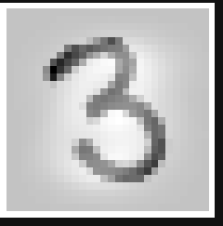




Not edited
Standardized
Binarizer
MinMax
MaxAbs
MaxAbs-MinMax

Slide 4
HYPERPARAMETER
OPTIMIZATION

Slide 5
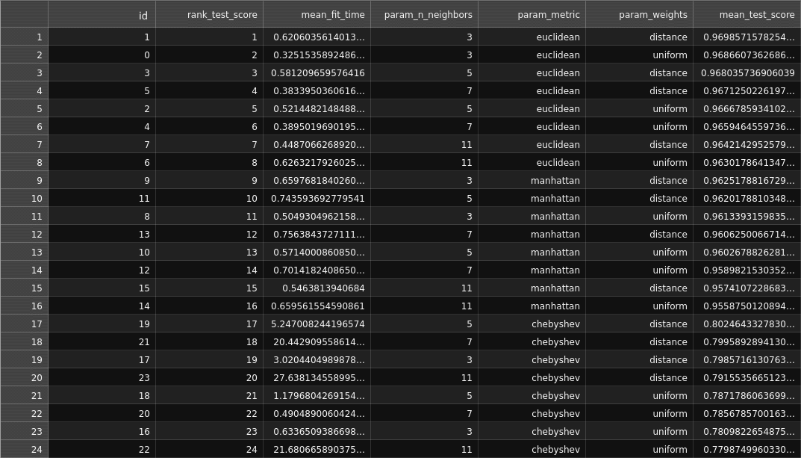
Grid-search cross-validation

Slide 6
results

Slide 7
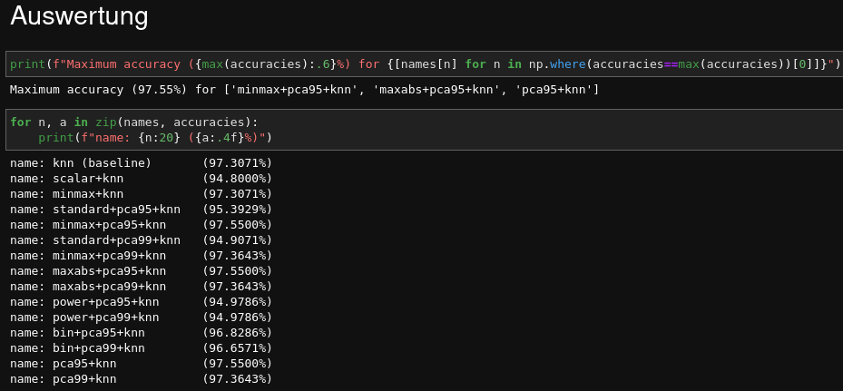
REsults

